Slide 1
Modern Agriculture
Srivalli Doppalapudi
Rohit Reddy Dyapa
Pavani Sri Padarthi
Gayatri Chenna

Slide 2
Overview
In recent years technology has increased and the farming techniques have improved a lot. The machinery is making farming easy. Every farmer can’t afford machinery. When the crop farming is seasonal, farmers don’t require a machine throughout the year. So instead of buying machinery, borrowing for rent is preferable. Sometimes the farmer needs the labour for farming, in that case calling the labour when the farmer needed is preferable. To make machinery and labour available for farmers as per farmer request, We are building the website with four modules named as administrator, machinery provider, labour provider and farmer.

Slide 3
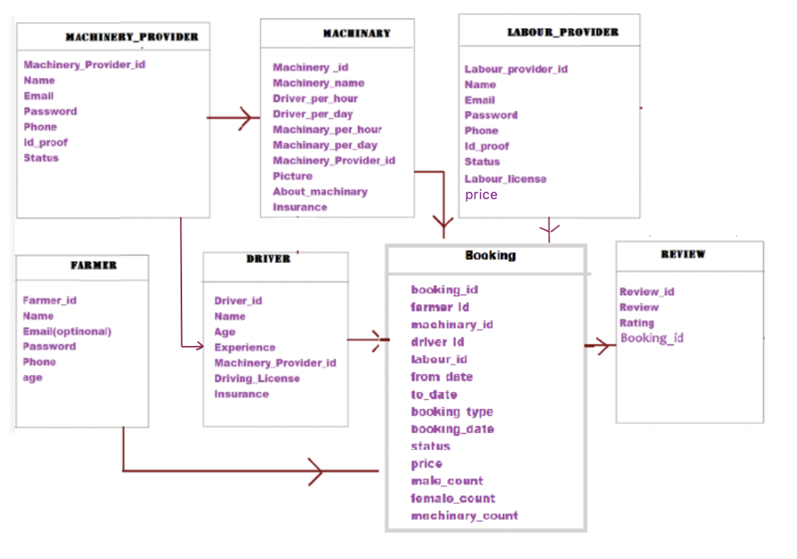
Collections

Slide 4


Technology

Slide 5
Admin
The administrator gets login with default credentials.
The administrator views the machinery provider and authorises the machinery provider.
The administrator views the machinery provider and authorises the labour provider.

Slide 6
Machinery Provider
The machinery provider gets login with the details like username and password only approval of the account by the administrator.
After getting logged in the machinery provider will be the driver for the machinery.
The machinery provider can view the driver.
The machinery provider adds the available machinery into the database.
The machinery provider can view the machinery added to the database.
The machinery provider can view the machinery booking.
The machinery provider views the booking, the machinery provider has the choice to approve the bookings or reject the bookings based on the availability of machinery.
If the farmer requires the driver then the machinery provider allots the driver and approves the booking.

Slide 7
Labour Provider
The labour provider gets login after the verification of the account by the administrator.
After getting logged in the labour provider can view the profile.
The labour provider can view the bookings, the labour provider can accept or reject the bookings.
The labour provider can view the history.

Slide 8
Farmer
The farmer gets registration before login.
The farmer gets login with the details like email and password.
The farmer can view the available machinery and book the machinery by selecting the from date to date and driver requirement.
After selecting the booking date and driver requirement the farmer can view the details and can confirm booking.
The farmer can view the available labour providers and make booking by selecting from date to date, male count and female count.
The farmer can view billing details and make it confirm.
The farmer can view the bookings and the farmer can give reviews and ratings for the booking.

Slide 9
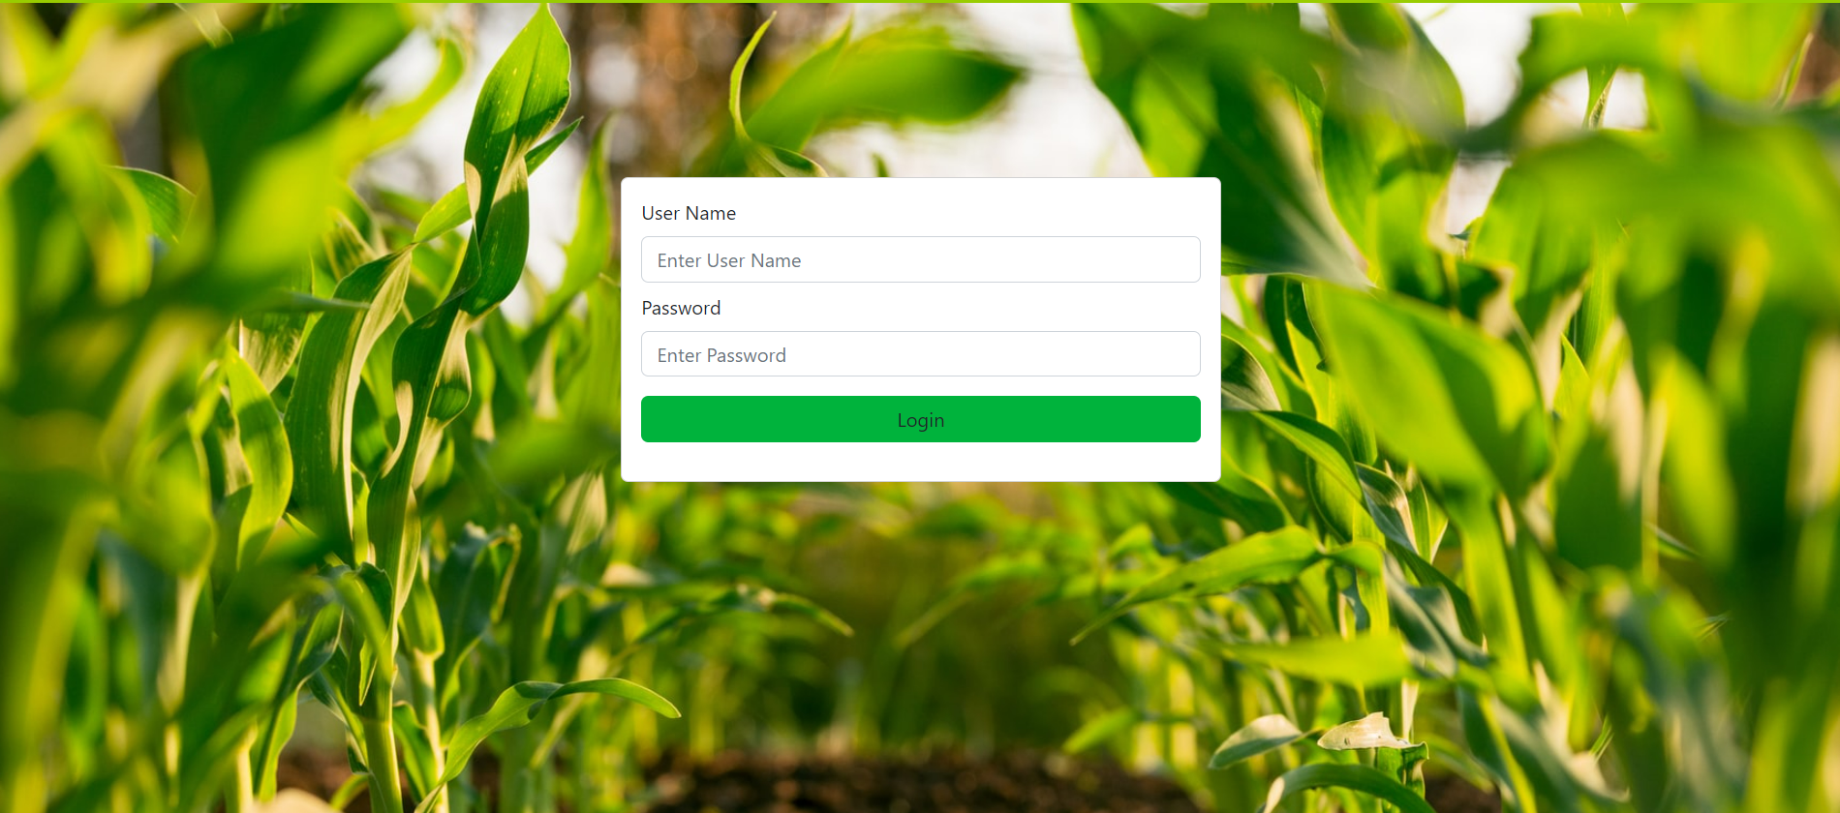
Admin Login

Slide 10
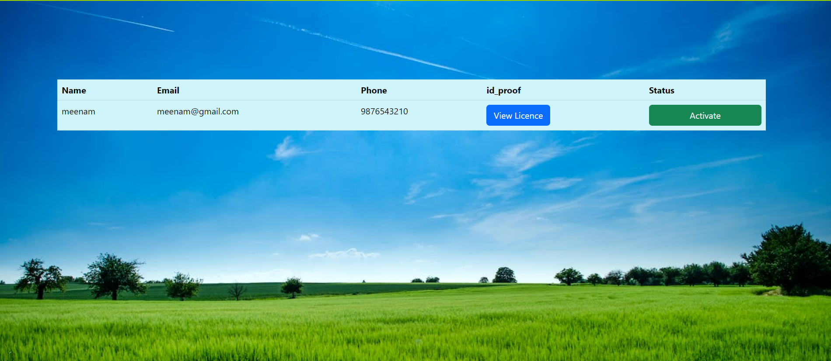
View Machinery Provider

Slide 11
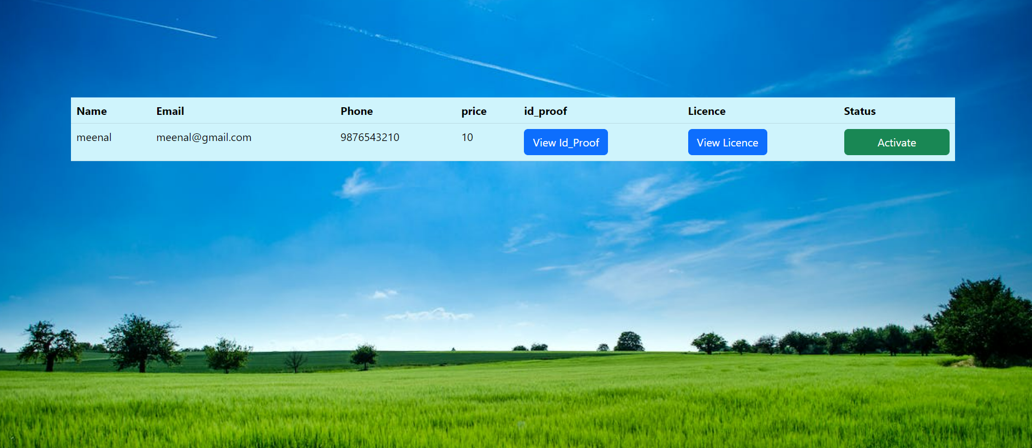
View Labour Provider

Slide 12
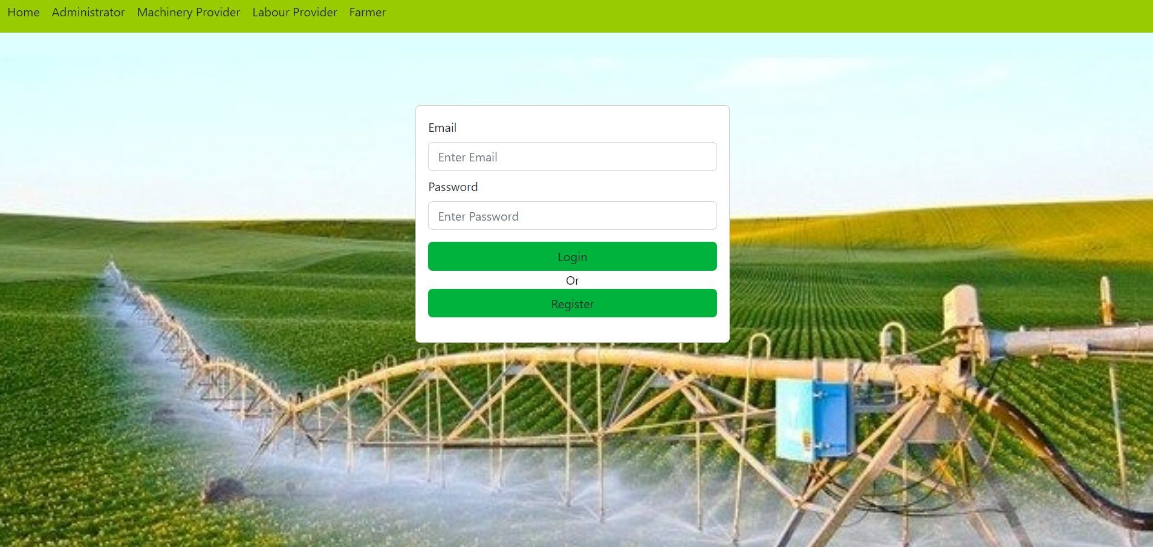
Machinery Provider Login

Slide 13
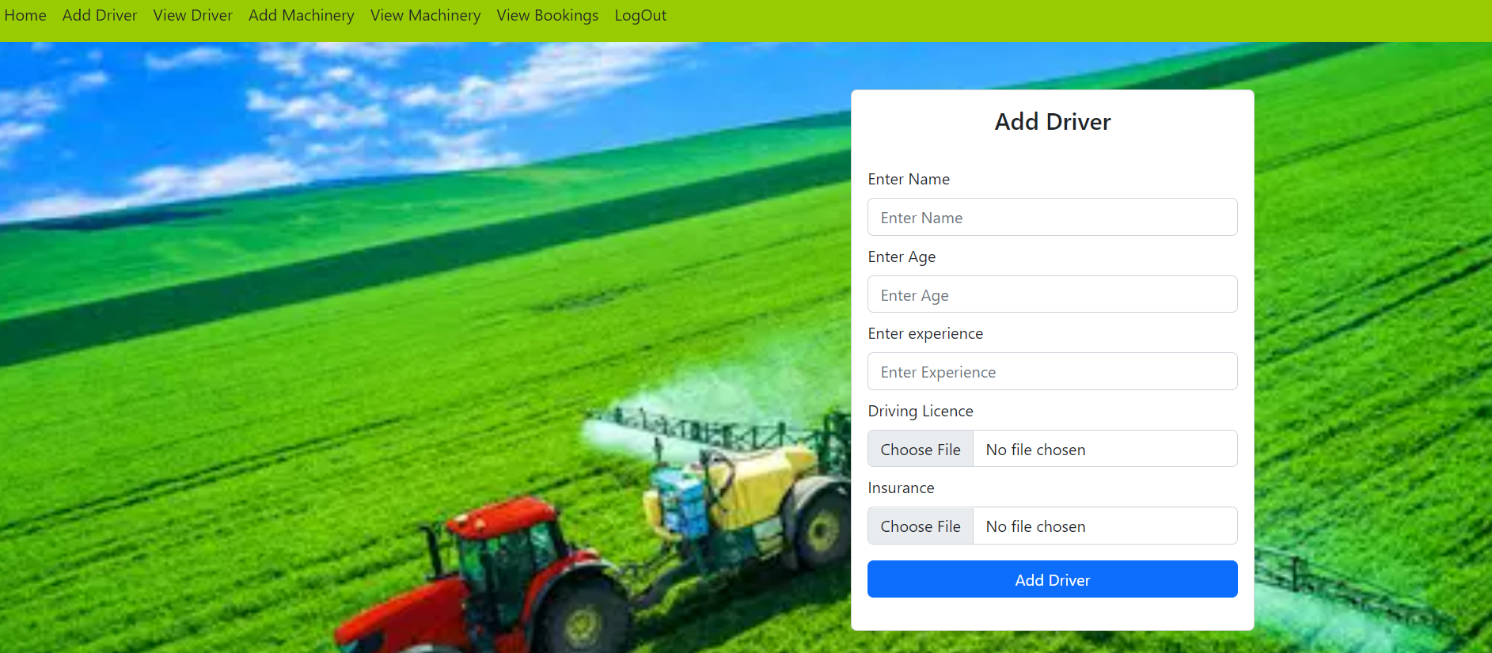
Add Driver

Slide 14
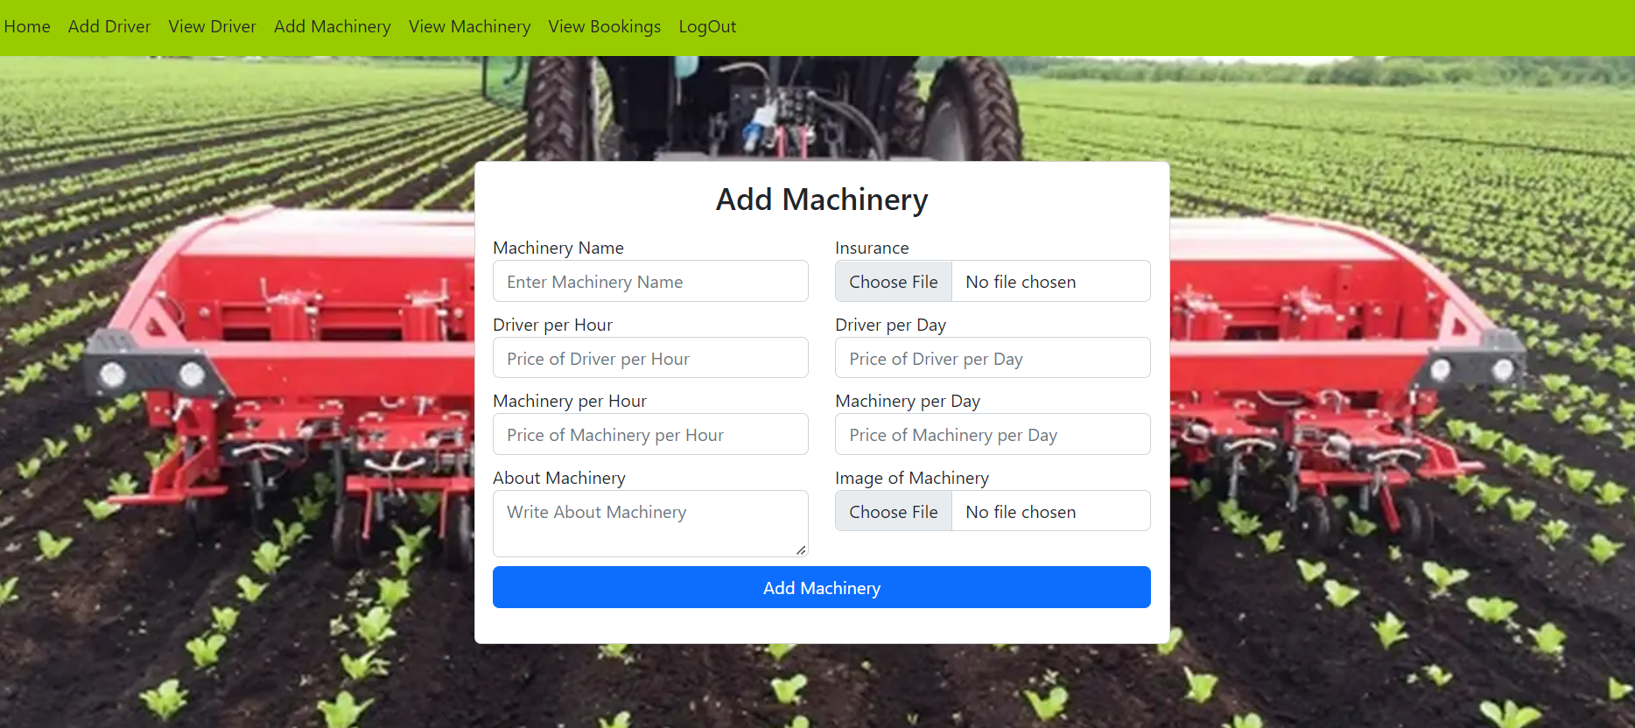
Add Machinery

Slide 15
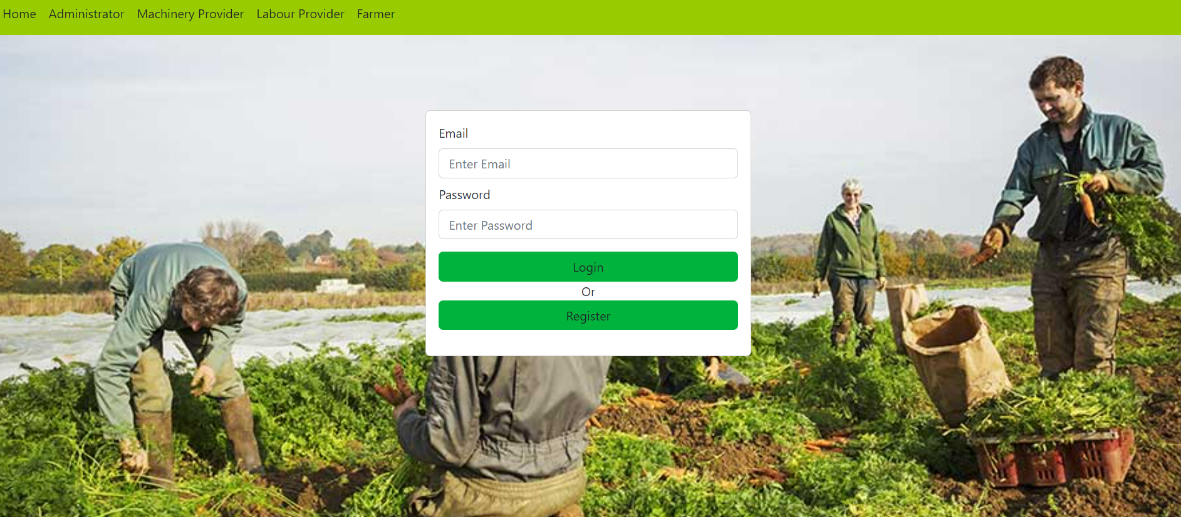
Labour Provider Login

Slide 16
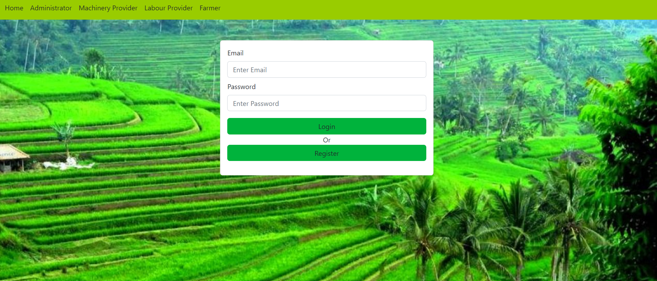
Farmer Login

Slide 17


